Slide 1
2024–2025
Statewide Assessments
Paper Based Accommodated Return
District Coordinator/
Security Box

Slide 2
Overview
These training materials are based on the 2024–2025 Statewide Assessments Accommodations Guide (2024–2025 Accommodations Guide) and the Spring/Summer 2025 Test Administration Manual (Spring/Summer 2025 TAM)
These guides are provided in an online format only and are posted to the Florida Statewide Assessments Portal.
This presentation is designed to highlight important information regarding test administration policies and procedures.
This presentation is not a replacement for reading the 2024–2025 Accommodations Guide or the Spring/Summer 2025 Test Administration Guide.

Slide 3
Appendix A: Paper-Based
Materials Return Instructions
Appendix A of the 2024–2025 Accommodations Guide provides instructions for preparing and packaging materials for return for the Spring/Summer 2025 administrations.
School assessment coordinators should familiarize themselves with these instructions prior to preparing materials for return after any paper-based test administration.

Slide 4
Reminders
All “To Be Scored” and “Not To Be Score” materials will ship from each school directly to DRC/Pearson via UPS
Schools will still return the District Coordinator (DC) box and Secure envelope/box to Evaluation Services at the end of the school year
Evaluation Services will send out the date and location of take in with your receipts at a later date
Separate materials by vendor/label color to ensure proper & timely processing

Slide 5
School Assessment Coordinator Responsibilities and Instructions
Missing Materials
School assessment coordinators must verify that all secure materials are received and should report any mispackaged or missing materials to their district assessment coordinator immediately.
The Test Materials Chain of Custody Form must be maintained at all times to track secure test materials.
Test administrators should report any missing materials to the school assessment coordinator immediately.
Schools must investigate any report of missing materials.

Slide 6
Not To Be Scored Paper
  FAST ELA Reading
  FAST Math
  Grades 5 & 8 Statewide Science
  FAST ELA Reading Retake
  B.E.S.T. Alg 1 EOC
  B.E.S.T. Geometry EOC
  Biology 1 EOC
  Civics EOC
  US History EOC
  FCLE

Slide 7
Prepare Materials – Not to Be Scored
Confirm that all scorable tests have been entered into the Data Entry Interface (DEI) for the following subjects:
  FAST ELA Reading
  FAST Math
  Grades 5 & 8 Statewide Science
  FAST ELA Reading Retake
  BEST Alg 1 EOC
  BEST Geometry EOC
  Biology 1 EOC
  Civics EOC
  US History EOC
  FCLE

Slide 8
School Assessment Coordinator Responsibilities and Instructions
Enter Student Responses into the DEI
All regular print, large print, and one-item-per-page paper-based assessments must be transcribed by school into the Data Entry Interface (DEI), with the exception of the B.E.S.T. Writing assessment which are not entered into the DEI. These materials are transcribed into regular print documents and returned to DRC for scoring.
Braille materials can be entered into the DEI locally or returned to DRC or Pearson for transcription and DEI entry, except for Braille B.E.S.T. Writing assessments which are not entered into the DEI and must be returned to DRC for transcription and scoring.
Any test and response books returned to DRC without being first recorded into the DEI will not be scored. More information about the DEI can be found in the DEI User Guide.

Slide 9
School Assessment Coordinator Responsibilities and Instructions
Invalidated DEI Tests
If a paper-based FAST, Statewide Science, FCLE, or EOC test needs to be invalidated, it should be entered into the DEI.
Then follow the instructions for invalidating a CBT test in the TIDE User Guide. Invalidations must be entered in TIDE by the last day of the test administration window.
    Prepare Materials for Return
    Follow instructions from your district assessment coordinator regarding the return of secure materials. Reference Appendix A as needed.

Slide 10
To Be Scored Paper
B.E.S.T. Writing (Grades 4-10)
This assessment is not entered into the DEI

Slide 11
Prepare Materials – To Be Scored PBT
Inspect all secure materials individually to ensure they will be processed accurately:
  Pre-ID label is applied
  Remove stray marks from security number barcode
  Remove any stray planning sheets from TBS test documents
  DO NOT review test content, student responses, or check through books for stray marks
  Verify that the DNS/Undo bubbles in the SCHOOL USE ONLY box are used correctly

Slide 12
DNS Bubble - PBT
Verify that no DNS bubbles have been gridded by mistake.
If a DNS bubble has been gridded by mistake, erase the DNS bubble and grid the UNDO bubble, and place the document with TO BE SCORED materials.
Grid the DNS bubble and place the document with TO BE SCORED materials if:
  a test has been invalidated for any of the reasons listed on pages 23–24 of the Spring/Summer 2024 Manual and at least one security seal on the test has been broken.
Grid the DNS bubble and place the document with NOT TO BE SCORED materials if:
  a test document has a PreID label applied and no security seals have been broken
  a test document is defective and has a PreID label applied
It is not necessary to grid the DNS bubble if a test document is defective and a PreID label has not been applied. Place the document with NOT TO BE SCORED materials.

Slide 13
Packing Materials
Materials do not need to be sorted by subject or special program if they require the same type of return label. See label colors chart for materials groupings.
If using plastic return bags for DRC materials, place the bag in a DRC box. Then, add all TO BE SCORED regular print materials in the plastic return bags.
Place all materials facing in the same direction or divide the stack of materials into two halves with each half facing a different direction.
  Do not alternate individual books in different directions.
  Use the provided zip ties to securely close the bags.

Slide 14
Packing Materials
If not using plastic return bags, place all TO BE SCORED regular print materials directly in DRC boxes. Use filler such as crumpled paper or bubble wrap to make sure the materials do not shift during transport, but do not use paper bands, rubber bands, or any other extra materials to separate documents.
Tape the boxes securely using several strips of heavy-duty shipping tape.
Affix the appropriate colored return label to the top of each box. Labels may be placed over any existing shipping labels (e.g., vendor or carrier labels).

Slide 15
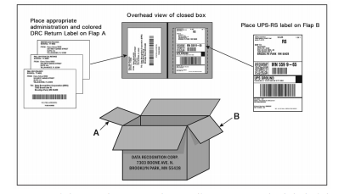
UPS Return – DRC/Pearson
To Be Scored
- All To Be Scored Boxes will have a colored label (Vendor/Grade/Subject) and a UPS label affixed to each box

Slide 16
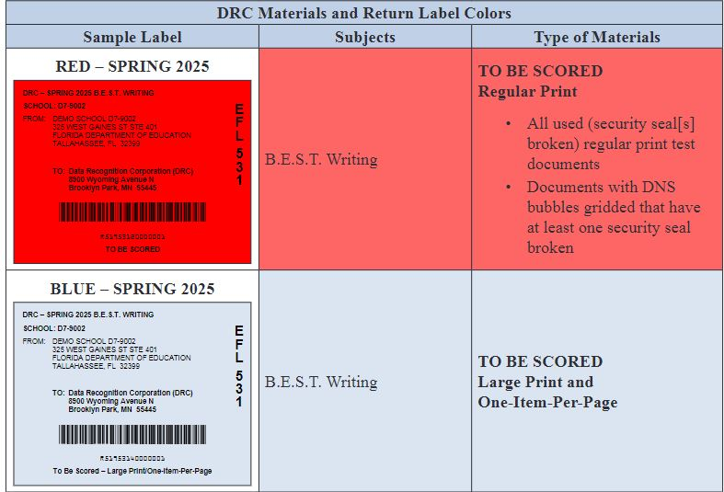
DRC

Slide 17
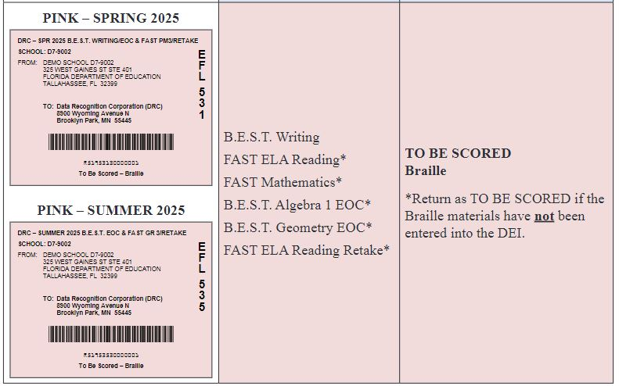
DRC

Slide 18
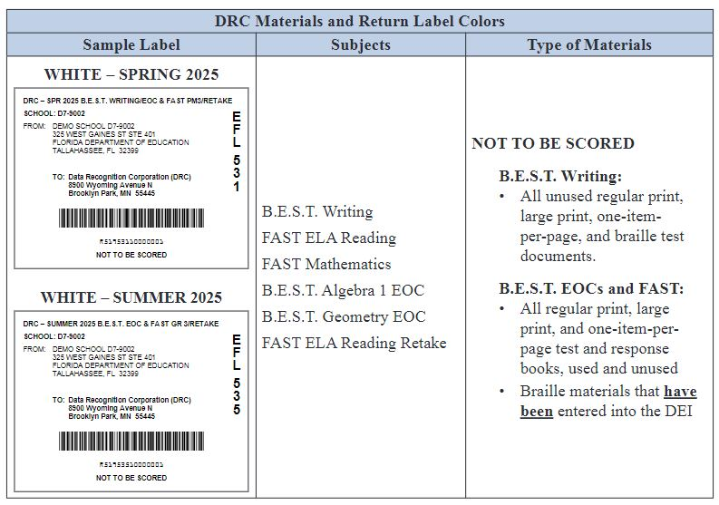
DRC

Slide 19
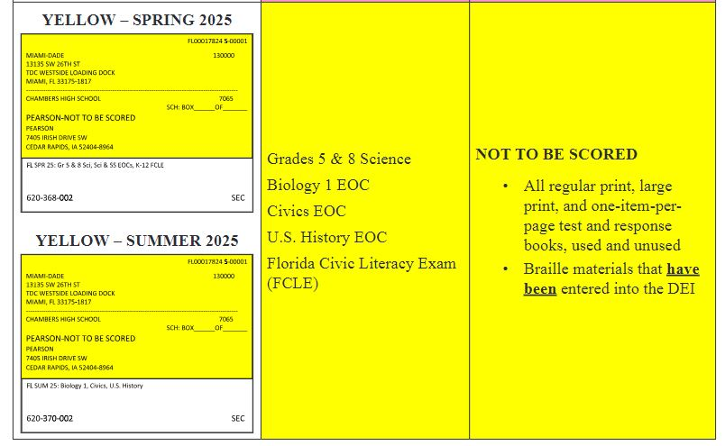
Pearson

Slide 20
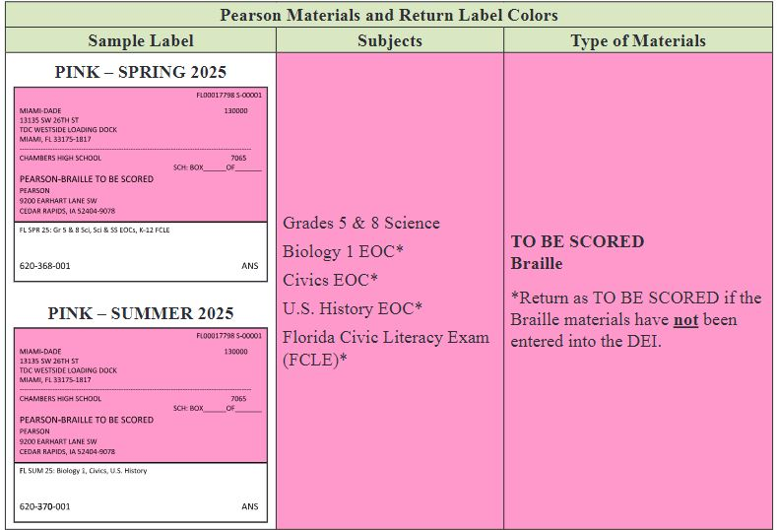
Pearson

Slide 21
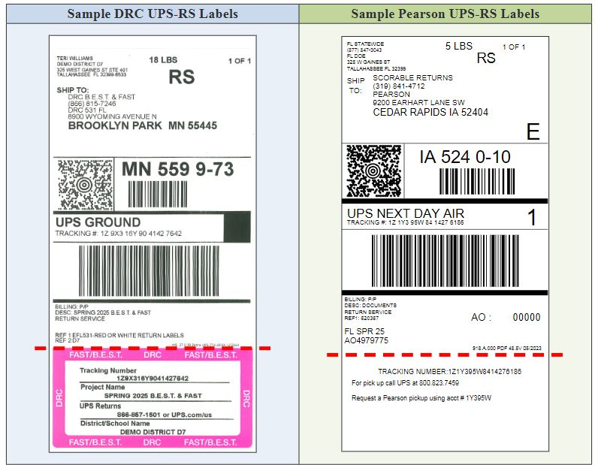
UPS Labels – DRC/Pearson

Slide 22
UPS Return – DRC/Pearson
    You may return your UPS materials the following ways:
    • Drop Off: Take your materials to a UPS Customer Center or Store.
    • Daily Pickup: Return with your daily on-route pickup. If you have more than 10 boxes, contact UPS to ensure the driver is properly equipped.
    • Schedule Online: Schedule a pickup at www.ups.com/us, then click on Shipping > Schedule a Pickup.
    ▪ Separate pickups must be scheduled for DRC (FAST/BEST Writing) and Pearson (NGSSS & FCLE) returns.
    ◦ The same pickup date and time can be used for both vendors.
    ◦ Document the number of boxes per vendor and apply the correct UPS-RS labels to each box.

Slide 23
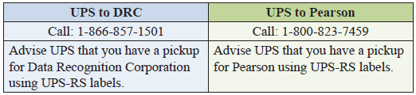
UPS Pick Up

Slide 24
School Assessment Coordinator Responsibilities and Instructions
Hazardous Materials
If a test document is soiled (e.g., with blood, vomit), the school assessment coordinator should contact their DAC (Nate). All hazardous materials must be reported by the last day of the test window. At their discretion, school personnel may transcribe responses into a replacement test document.
The damaged test document should then be destroyed or disposed of in a secure manner (e.g., shredding, burning). Soiled test documents should not be returned with test materials.

Slide 25
District Coordinator Box/Security Envelope
DO NOT follow the instructions in the Spring/Summer manual
Make copies of all applicable testing documents to keep at your school as outlined in General Records Schedule GS7 for Public Schools PreK-12 and Adult and Career Education:
  Chain of Custody (PBT only, if used)
  Administration Records
  Security Logs
  Seating Charts
  Signed Test/Prohibited Activities Agreements

Slide 26
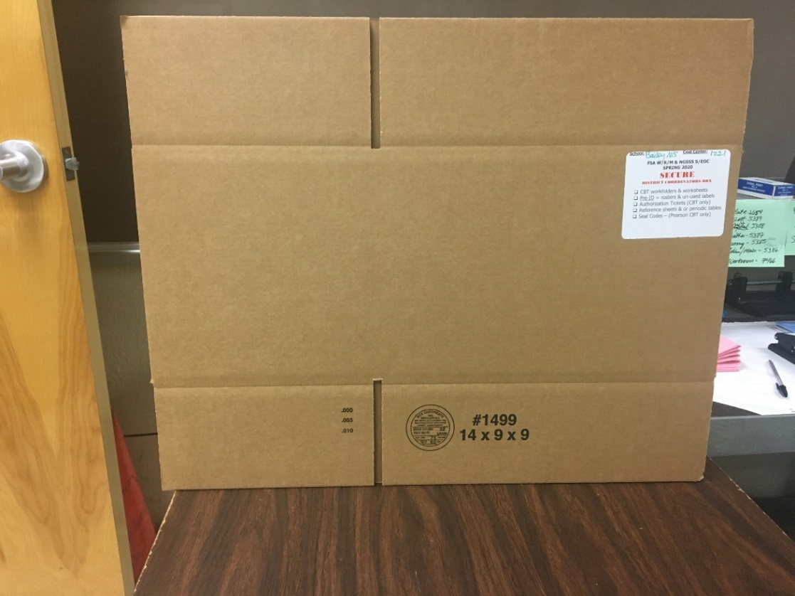
District Coordinator Box
All schools will receive a DC Box

Slide 27
DC Box (6 month materials)
Place the following materials, as applicable, in the District Assessment Coordinator ONLY boxes
Originals of:
  Log- in Tickets (CBT)
  Writing Planning Sheets (CBT & PBT)
  Work Sheets/Folders (CBT & PBT)
  Reference Sheets/Periodic Tables (CBT & PBT)

Slide 28
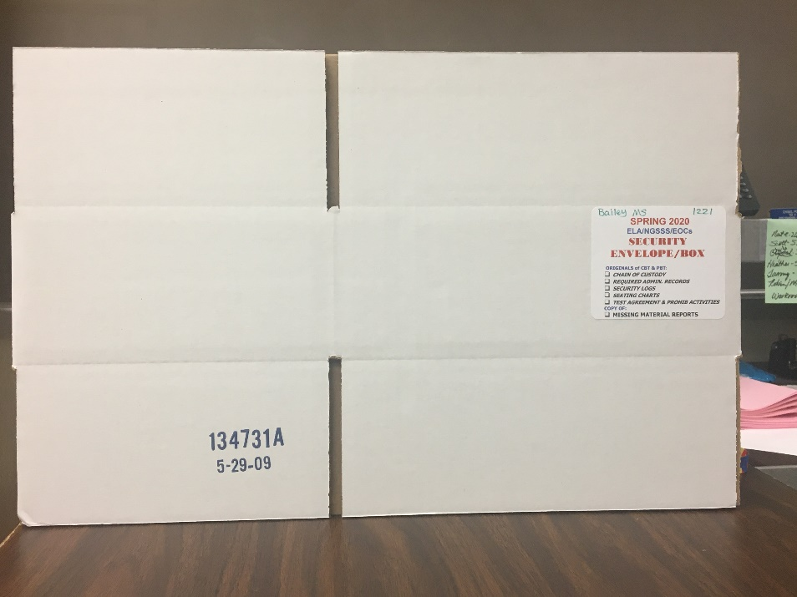
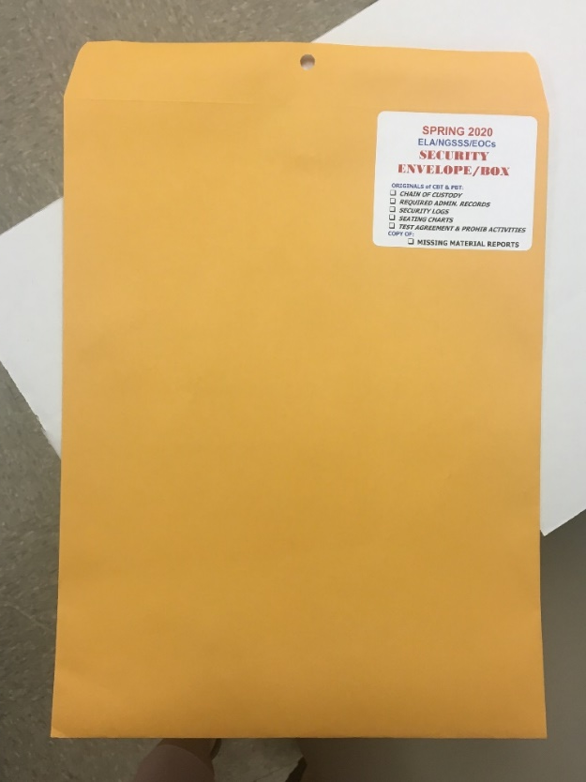
Security Box/Envelope (5 Year Materials)
Schools will receive either a Security Box or Security Envelope
Larger Schools
Smaller Schools/
Special Centers

Slide 29
Security Envelope
Security Envelope (5 year materials)
Originals (CBT & PBT)
Chain of Custody
Administration Records
Security Logs
Seating Charts
Signed Test/Prohibited Activities Agreements
Copy (If needed)
Missing Materials Reports

Slide 30

Questions
Call/Email me with questions
Heather Rykard, TSA
850-469-5387
hrykard@ecsdfl.us
** TIDE videos are posted on Evaluation Services webpage.
Be sure to check the Google classroom(s) for updates and new materials

Slide 31
Thank you for ensuring secure and successful
Spring/Summer 2024 test administrations!

